Slide 1
Secure Data Hiding in Image Using Steganography
CAPSTONE PROJECT
Presented By: Anurag Anil Yamnurwar
Student Name : Anurag Anil Yamnurwar
College Name : Priyadarshini College of Engineering Nagpur
Department : Information Technology

Slide 2
OUTLINE
Problem Statement
Technology used
Wow factor
End users
Result
Conclusion
Git-hub Link
Future scope

Slide 3
Problem Statement
Traditional encryption methods can attract attention, making data more susceptible to attacks.
Secure communication requires a method that keeps sensitive data hidden in plain sight.
Existing steganography techniques may lack robustness and security against detection.
Need for an efficient and secure image-based steganography system.

Slide 4
Technology used
Programming Language: Python
Libraries: OpenCV, Tkinter, Pillow.
File Handling & Security: Basic encryption logic for password protection
Platform: Windows 11

Slide 5
Wow factors
Combines steganography and encryption for enhanced security.
Works on grayscale & colored images with minimal distortion.
Ensures high imperceptibility to human vision and detection tools.
Can be extended for audio and video steganography in the future.
User-friendly GUI for easy encryption and decryption.

Slide 6
End users
Government agencies for secure communication.
Cybersecurity professionals for data protection.
Individuals needing private data storage.
Journalists/Activists in high-risk environments.
Software Developers Learning steganography concepts and their applications.

Slide 7
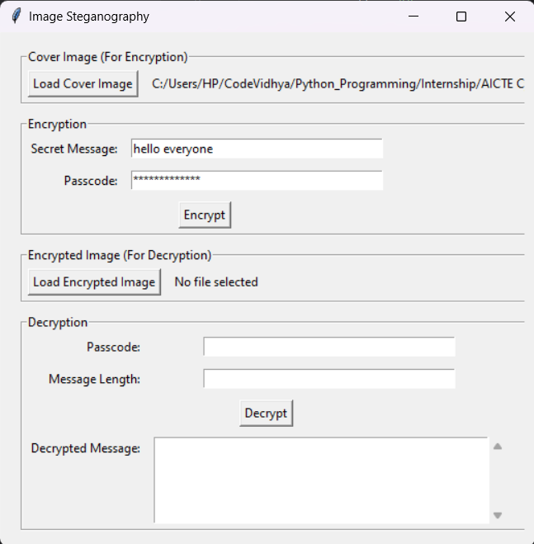
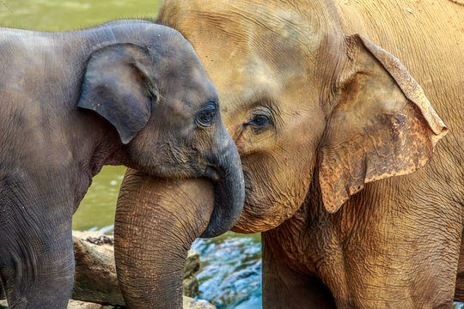
Results
GUI:
Input Image File:
Encrypted Image File:

Slide 8
Conclusion
Successfully developed a steganography-based secure data hiding technique.
Maintains image quality while embedding information.
This project showcases a simple yet effective implementation of message hiding in images.
The GUI makes encryption and decryption accessible even to non-technical users.
Can be improved with advanced encryption and AI-based detection resistance.

Slide 9
GitHub Link
https://github.com/anurag-yamnurwar/Secure-Data-Hiding-in-Image-Using-Steganography

Slide 10
Future scope(optional)
Enhance security with deep learning-based steganalysis resistance.
Implement video and audio steganography.
Mobile App & Web Version – Expanding accessibility beyond desktops.
Multi-Layer Security – Combining steganography with blockchain for ultra-secure communication.
Optimize for real-time applications like secure cloud storage.

Slide 11
THANK YOU

